Slide 1
Transport Layer – TCP
Computer Networks
1

Slide 2
Transmission Control Protocol (TCP)
Transmission Control Protocol properties:
Connection-oriented (establishment & termination)
Reliable
Full-duplex
Connection oriented means that a virtual connection is established
before any data is transferred
Connection ensures that the receiving process is available and
ready before the data is sent

Slide 3
Connection-Oriented
Three-way handshaking connection establishment procedure because TCP is full-duplex both side must initialize communication and get approval from the other side before any data transfer
TCP protocol will make sure that segments are given to the receiver application in the same order as they were sent by the sender even if they travel through different physical paths
A server application that uses TCP can handle many client requests at the same time each has its own connection

Slide 4
TCP Connection, Establishment and Termination
Three-Way Handshake
Establishes that the destination device is present on the network
Verifies that the destination device has an active service and is accepting requests on the destination port number
Informs the destination device that the source client plans to establish a communication session on that port number

Slide 5

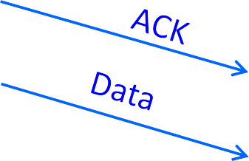
Establishing a TCP Connection
Three-way handshake to establish connection
Host A sends a SYN (open) to the host B
Host B returns a SYN acknowledgment (SYN ACK)
Host A sends an ACK to acknowledge the SYN ACK
A
B

Slide 6
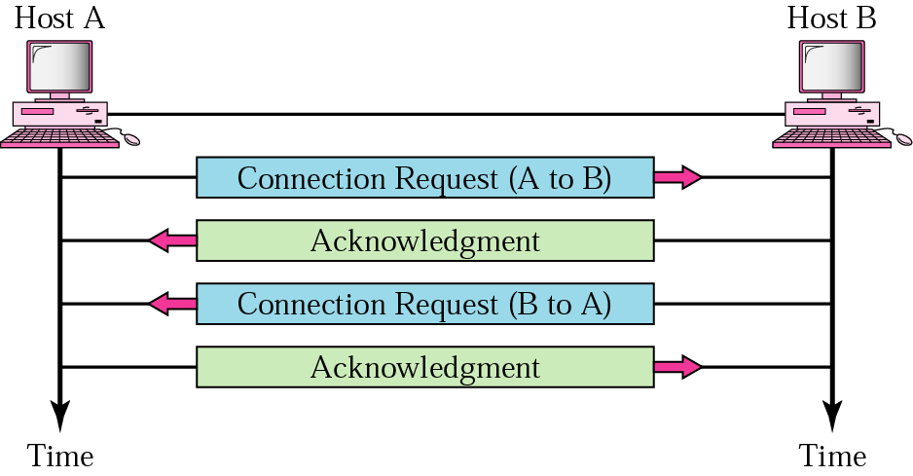
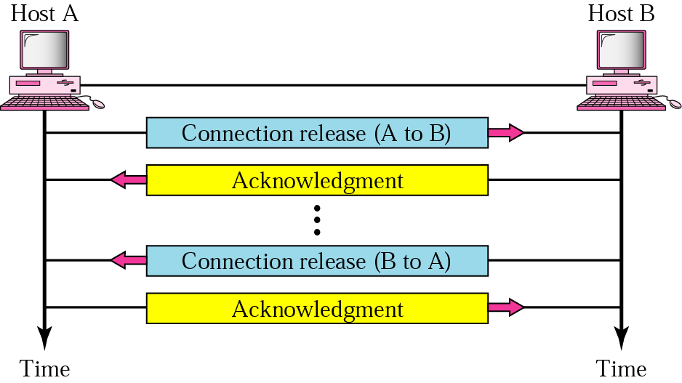
Connection Establishment and Termination
Connection establishment
Combined into one step
Connection release

Slide 7
Full Duplex
Data segments can flow in both directions at the same time
Each TCP connection has its own sending and receiving buffers

Slide 8
Flow Control and Reliability
Problem: how many packets should a sender transmit?
Too many packets may overloaded the receiver
Size of the receivers buffers may change over time
Solution: sliding window
Receiver tells the sender how big their buffer is called the advertised window
After each ACK, the window slides forward
8

Slide 9
Flow Control and Reliability
Error control (process-to-process): Entire message arrives at the receiving transport layer without error, loss, duplication and in the same order they were sent
Error detection is done using checksum and correction by retransmission
Every transmission of data is acknowledged by the receiver
If the sender does not receive ACK within a specified amount of time, the sender retransmits the data

Slide 10
How TCP Provides Reliability
TCP breaks application data into best sized chunks (segments)
TCP maintains a timer for each segment, waiting for acknowledgement
TCP retransmits segment if ACK is not returned before timeout
When TCP receives data it sends an acknowledgement back to sender

Slide 11
How TCP Provides Reliability
TCP maintains end-to-end checksum on its header and data
TCP re sequences data at the receiving side, if necessary
TCP discards duplicate data at the receiving side
TCP provides flow control

Slide 12
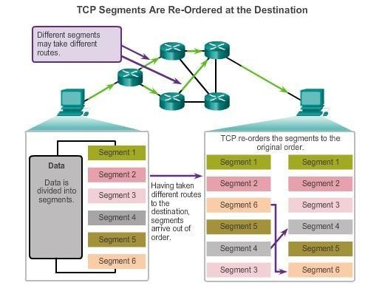
TCP Reliability – Ordered Delivery
Sequence numbers used to reassemble segments into original
order

Slide 13
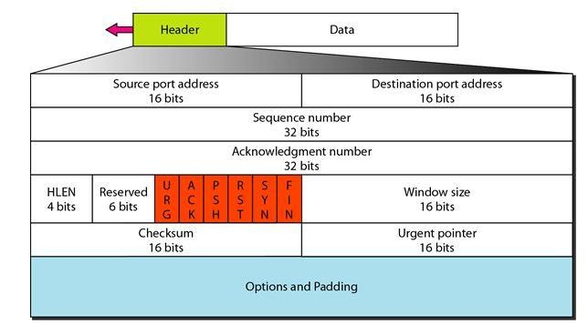
TCP Header

Slide 14
TCP Header Fields
Reserved—Used by TCP to negotiate certain features between the end-points, e.g., maximum segment size (MSS)
Flags (also known as control bits)—Contains 6 (1-bit flags)
Window—It contains the size of the receiving window of the sender
Checksum—Used for error-checking of the header and data

Slide 15
TCP Header Fields
The header consists of 11 fields, of which 10 are required:
Source port—Identifies the sending application
Destination port—Identifies the destination application
Sequence number—Used for assembling segmented data in the proper order
at the receiving end
Acknowledgement number—Contains the next sequence number that the receiver (sender of the ACK) is ready to receive.
Header Length—The size of the TCP header, it is also the offset from the start of the TCP packet to the data portion

Slide 16
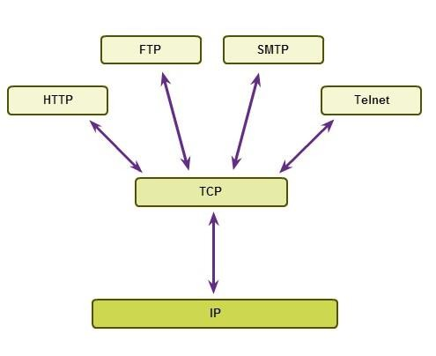
Applications that use TCP

Slide 17
User Datagram Protocol (UDP)

Slide 18
User Datagram Protocol (UDP)
Connectionless
No handshaking between UDP sender, receiver
Each UDP segment handled independently
A server application that uses UDP serves only ONE request at a time. All other requests are stored in a queue waiting for service

Slide 19
User Datagram Protocol (UDP)
It uses port numbers to communicate application layer
Advantages: Simple, minimum overhead, no connection delay
Services provided by UDP:
Process-to-Process delivery
Error checking (however, if there is an error UDP does NOT do anything to recover from error. It will just discard the message)

Slide 20
UDP Server and Client Processes
UDP-based server applications are assigned well known or registered port numbers
UDP client process randomly selects port number from range
of dynamic port numbers as the source port

Slide 21
UDP Applications
UDP
Simple protocol that provides the basic transport layer functions
Used by applications that can tolerate small loss of data
Used by applications that cannot tolerate delay
Used by
Domain Name System (DNS)
Simple Network Management Protocol (SNMP)
Dynamic Host Configuration Protocol (DHCP)
Trivial File Transfer Protocol (TFTP)
IP telephony or Voice over IP (VoIP)
Internet Protocol television (IPTV)

Slide 22
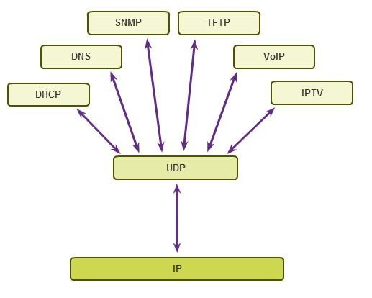
Applications that use UDP

